Slide 1
Cost Of Attendance
Part 1
College Prep
Mr. Gordon
jgordon@bisdtx.org

Slide 2
Upcoming Events
Fri. Nov. 22 Texas State University Visit
hi

Slide 3

What is C.O.A.?
C.O.A. stands for Cost of Attendance
This is the price of attending one year (Fall and Spring Semesters, not Summer) at a university.
hi

Slide 4
What is Cost of Attendance?
Cost of Attendance is typically split into 5 categories
Tuition and Fees
Room and Board
Books and Supplies
Personal and Miscellaneous
Travel
Texas State C.O.A.
hi

Slide 5
What is Cost of Attendance?
On the following slides, we will go over each of these categories.
It is important to remember that most students do not pay the full cost of attendance.
Almost all students receive financial assistance in the form of scholarships, grants, and loans.
(We will go over these in a later College Prep)
hi

Slide 6
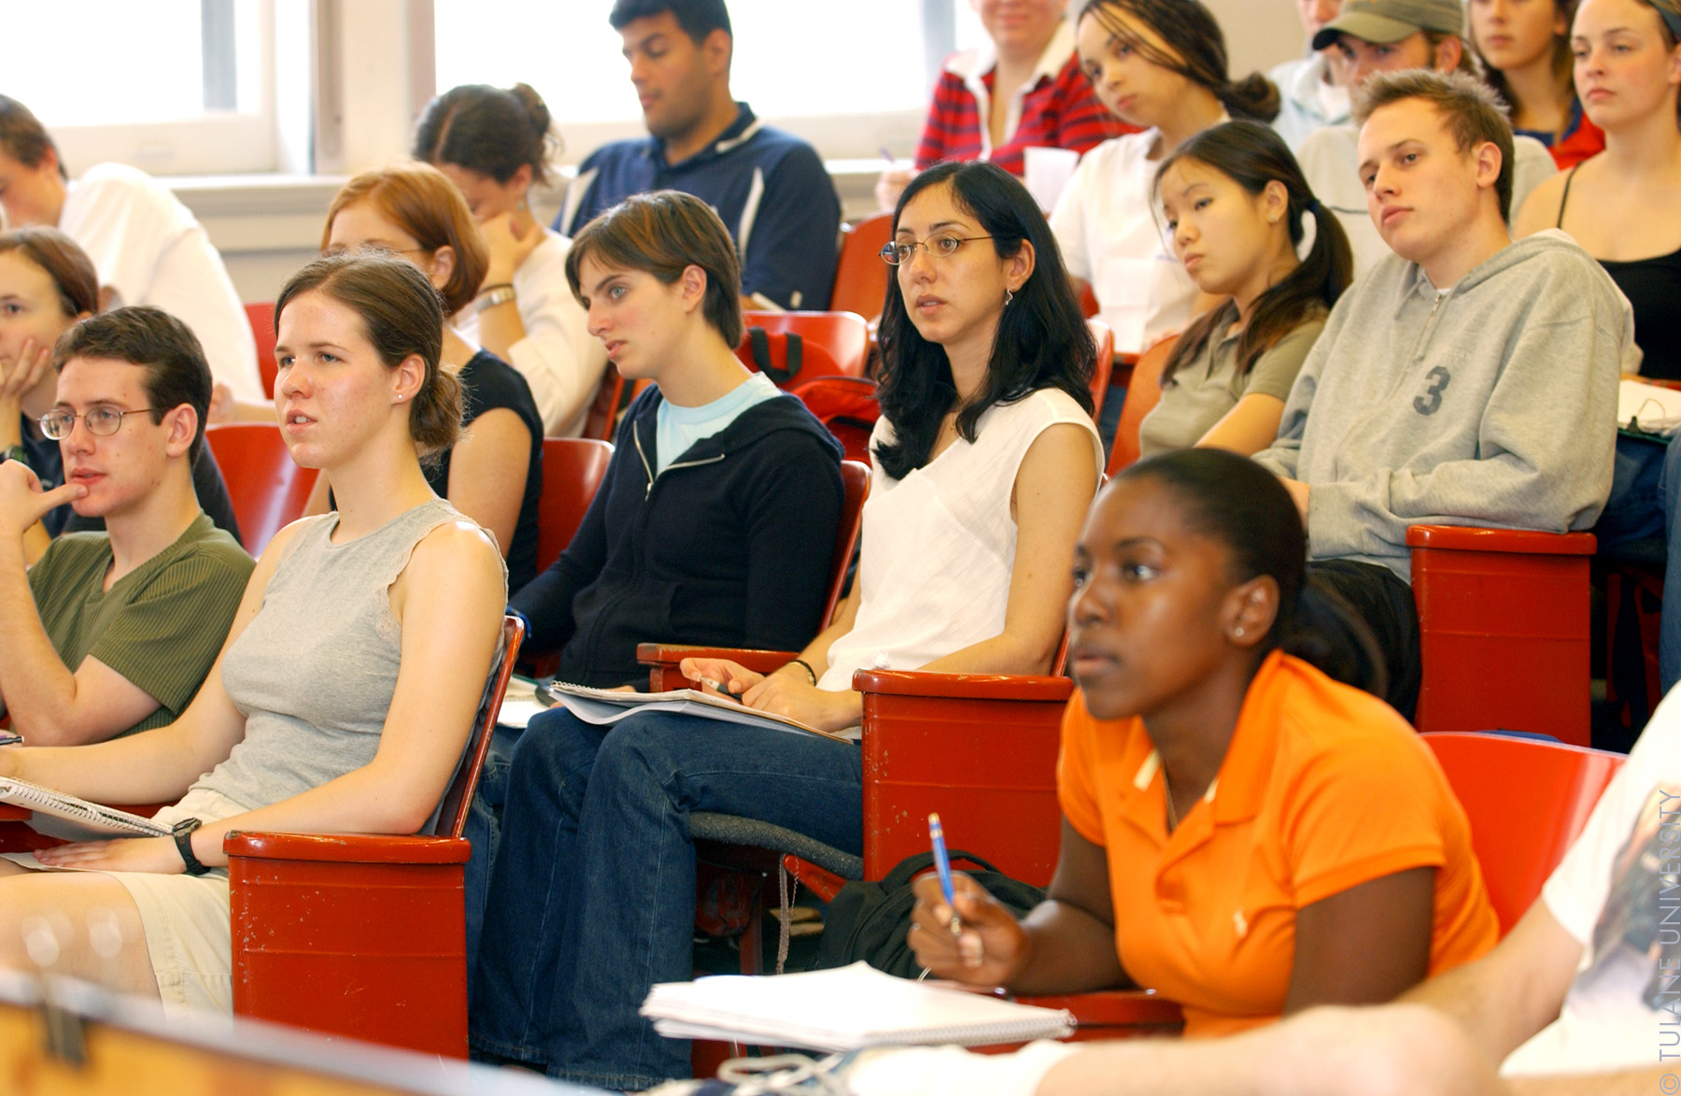
Tuition and Fees
Tuition and Fees is the biggest expense of going to college.
This is the cost of taking courses at the university and any lab, technology, or parking fees.
This amount is a set fee and is the same for all students.
2022-2023 Texas State University cost of tuition
$11,860
hi

Slide 7
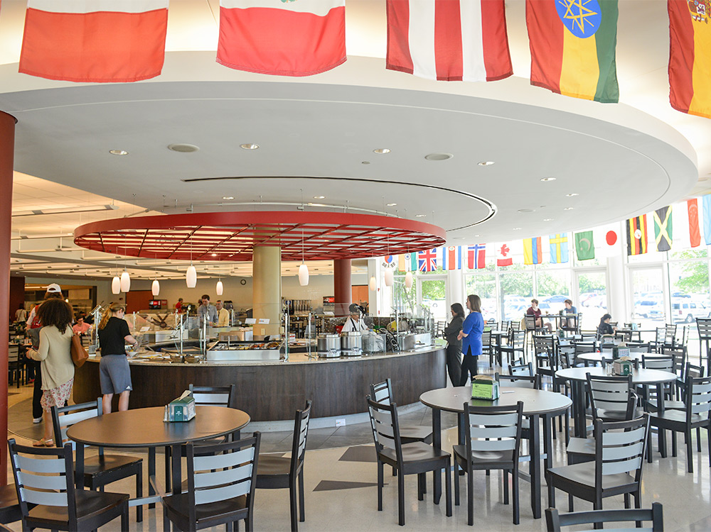
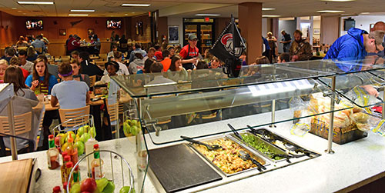
2. Room and Board
Room and Board is the second biggest expense.
This is the cost of living in a dorm and eating in the cafeteria.
hi

Slide 8
2. Room and Board
This cost can go up or down depending on:
How many roommates do you have?
Do you live in a newer dorm or an older one?
Do you you live at home and commute to college?
How many times a day, if at all, do you eat in the cafeteria?
Do you live in an off campus apartment?
2022-2023 Texas State University Estimated Cost of Room and Board
On Campus- $11,460
Off Campus (in San Marcos)- $10,260
With Parent- $4,010
hi

Slide 9
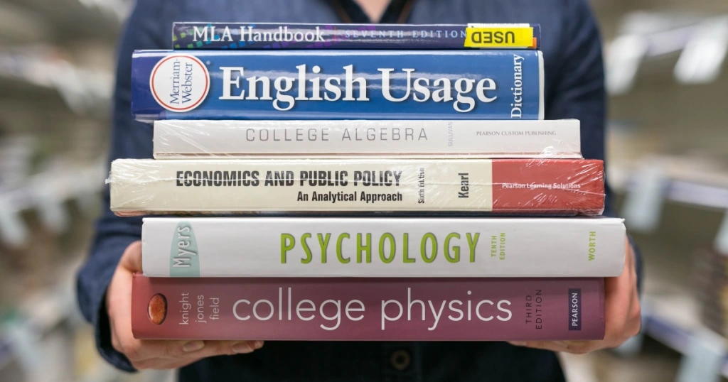
3. Books and Supplies
Books and Supplies is the cost of purchasing books for your classes.
The total cost usually depends on what major you are.
For example,
STEM books are typically more expensive because they are larger, hardback, and need to be the most recent editions.
English majors can buy used books.
2022-2023 Texas State University Estimated Cost of Book and Supplies
$790
hi

Slide 10
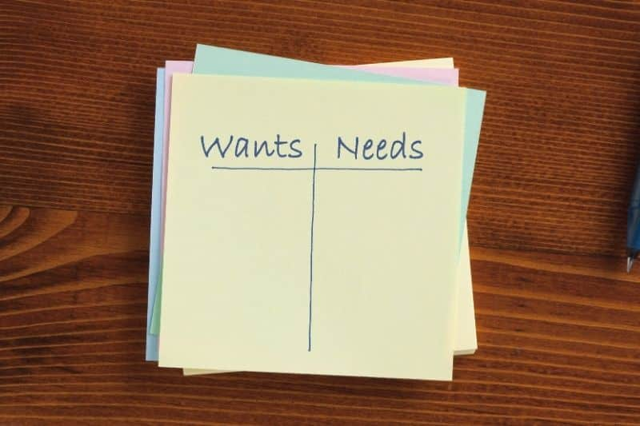
4. Personal and Misc.
Personal and Miscellaneous is the cost of taking care of your personal needs for nine months, such as buying pizza on a Friday night, buying shampoo, or a new pair of jeans.
This expense is based on your specific needs and wants.
2022-2023 Texas State University Estimated Cost of Personal and Misc.
$2,270
hi

Slide 11

5. Travel
Travel is the cost of going back and forth between home and university, job and campus, or around town.
This expense includes car loan, gas, and auto insurance.
hi

Slide 12
5. Travel
This expense can go up or down depending on:
Do you live at home and commute to college?
Do you own a car at college or just a bike?
Is your car paid for or are you still paying for it?
What type of car do you own?
Do you go to college in another state, which may require flying?
How often do you go home?
2022-2023 Texas State University Estimated Cost of Travel
On Campus- $1,340 (not driving as much)
Off Campus (in San Marcos)- $2,040 (to college and back to apartment)
With Parent- $3,740 (most likely driving further distances)
hi

Slide 13
Cost of Attendance
The total cost of a Texas resident attending Texas State University for the 2022-2023 School Year is:
On Campus- $27,720
Off Campus- $27,720
With Parent- $22,670
hi

Slide 14
Today’s College Prep Assignment
In the comments section of today’s College Prep,
answer the following question:
Using Google, find out the C.O.A. for Texas Tech University. Now look up one of the schools you are interested in attending.
hi

